Slide 1
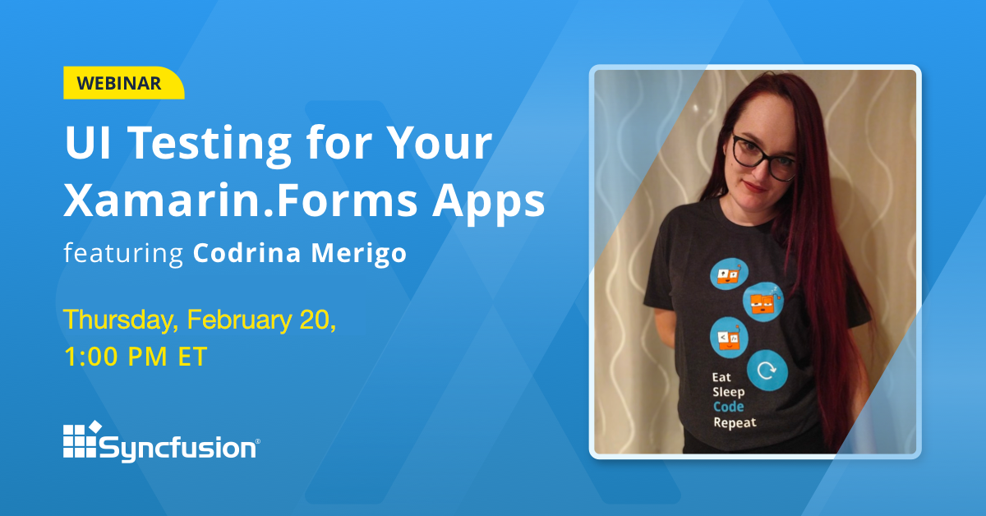

February 2020
Copyright © 2020 Syncfusion, Inc. All rights reserved.

Slide 2

PRESENTER
Codrina Merigo
Software Engineer
February 2020
Copyright © 2020 Syncfusion, Inc. All rights reserved.

Slide 3
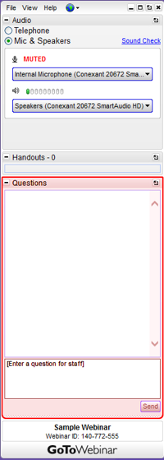
Q&A SEGMENT
Q&A segment will be at the end of the webinar.
Please enter your questions in the Questions window.
A recording of the webinar will be available within a week.
February 2020
Copyright © 2020 Syncfusion, Inc. All rights reserved.

Slide 4


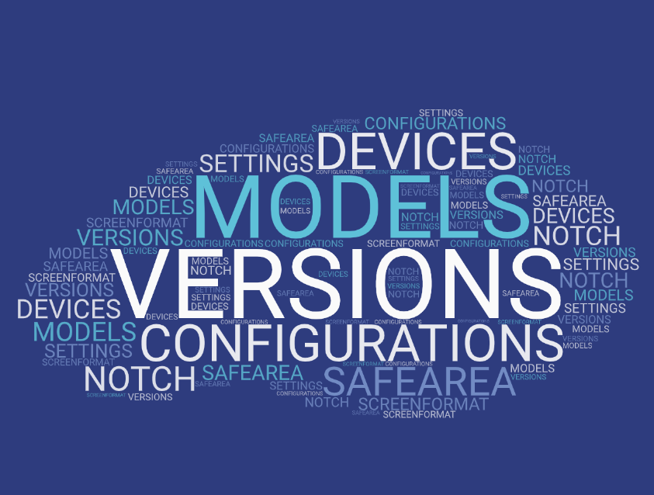

February 2020
Copyright © 2020 Syncfusion, Inc. All rights reserved.

Slide 5
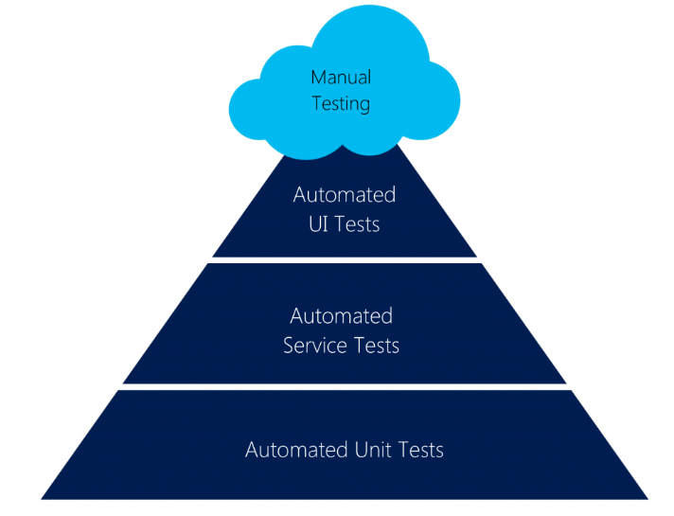
APP Testing
UI Tests This is the layer where you would be testing
the product more from an end-user’s perspective.
Your top priority would be to ensure that ‘UI Design Flow’
is in-line with the design requirements.
Service Tests helps you ensure that the services
are working properly and give you the right data.
Unit Tests are normally written by the developers who write test code to verify the functionalities that were developed by them.
Picture credits : https://mobilefirstcloudfirst.net/wp-content/uploads/2017/01/Test-Pyramid-1024x806.png
February 2020
Copyright © 2020 Syncfusion, Inc. All rights reserved.

Slide 6
Since the testing at UI level is so brittle,
it is recommended to focus on these tests
to only verify ‘UI flow & interactions’
without looking into the system functionality.
February 2020
Copyright © 2020 Syncfusion, Inc. All rights reserved.

Slide 7
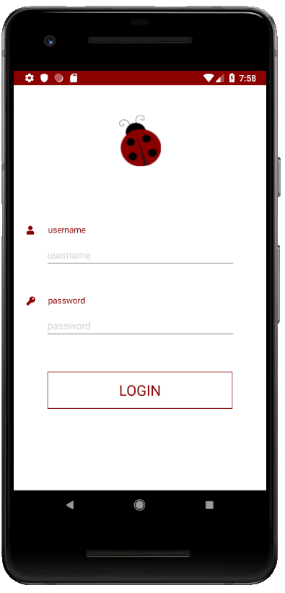
How would you test UI manually?
Lets say you want to login into an application.
You need to enter your username and password into the text field
and the password field respectively and then click on the “Login" button.
If you want to do it manually, you first search or locate where the username field is.
Then, you interact with it by typing your username into the field.
You would do the same with the password field.
You would then search or locate where the "Sign In" button is and click it.
Then you assure that you actually logged in.
1
February 2020
Copyright © 2020 Syncfusion, Inc. All rights reserved.

Slide 8
The two main tasks that you do manually are: Locate what the element you want and
Interact with it
1
1
2
You will do the same in your automated UI Test!
February 2020
Copyright © 2020 Syncfusion, Inc. All rights reserved.

Slide 9
FIRST Principles
Fast - ui tests are slow but dev must try not to write them even slower
Independent - not use other tests
Repeatable - not use constants like access tokens
Self-validating - by using asserts
Timely - try not to be very complicated, maybe an action can be split in multiple tests
February 2020
Copyright © 2020 Syncfusion, Inc. All rights reserved.

Slide 10

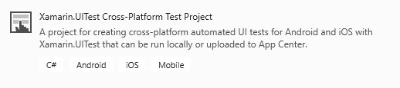
Setting up the project
February 2020
Copyright © 2020 Syncfusion, Inc. All rights reserved.
Notes:
Iapp.Flash

Slide 11
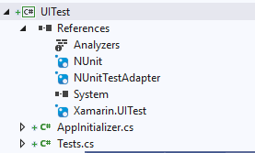
UI Test Project
if (platform == Platform.Android)
{
return ConfigureApp.Android
.EnableLocalScreenshots()
.DeviceSerial(DroidDeviceID)
.Debug()
.ApkFile(ApkPath)
.StartApp();
}
else
return ConfigureApp.iOS
.EnableLocalScreenshots()
.Debug()
.DeviceIdentifier(IOSDeviceID)
.AppBundle(AppPath)
.StartApp();
To find the ios device id run instruments -s devices on your mac,
for android launch adb devices from command line
ApkPath is something like "C:\Users\Projects\MyApp\MyApp.Android\bin\Debug\myApp.apk"
AppAPath for the ipa is something like ="../../../MyApp/MyApp.iOS/bin/iPhoneSimulator/Debug/MyApp.iOS.app"
February 2020
Copyright © 2020 Syncfusion, Inc. All rights reserved.

Slide 12


DEMO
February 2020
Notes:
Visual studio and project

Slide 13
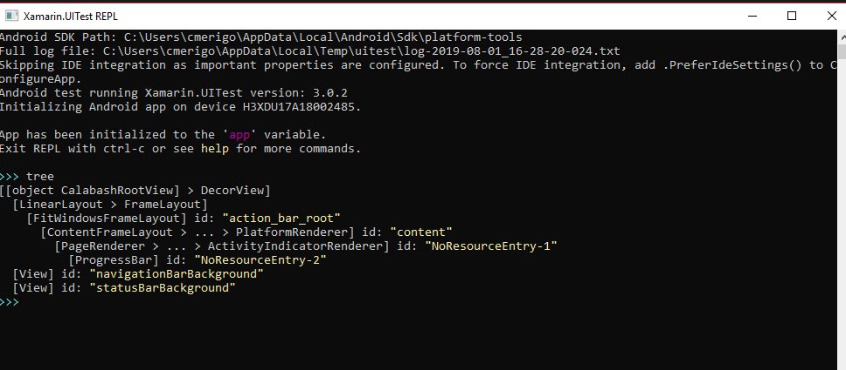
Repl() - read-eval-print-loop
The REPL is a console-like environment in which the developer enters expressions or commands.
It will then evaluate those expressions and display the results to the user.
tree
app.Query(e => e.All())
app.Flash(e=>e.All())
February 2020
Copyright © 2020 Syncfusion, Inc. All rights reserved.
Notes:
Iapp.Flash

Slide 14
The REPL is helpful when creating UITests as it allows us to explore the user interface
and create the queries and statements so that the test may interact with the application.
February 2020
Copyright © 2020 Syncfusion, Inc. All rights reserved.
Notes:
Iapp.Flash

Slide 15
DEMO
February 2020
Notes:
repl

Slide 16
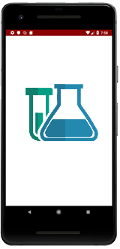
What should you UI Test for?
Verify your views and controls on the screen
Check for navigation between pages
Interact with ‘live’ elements like buttons, checkboxes, switches or tabs
February 2020
Copyright © 2020 Syncfusion, Inc. All rights reserved.
Notes:
aproaches

Slide 17
AAA Pattern
Arrange, Act, Assert
Sample
[Test]
public void TestMySum()
{
// Arrange
int a = 5;
int b = 7;
// Act
int result = MySum(a, b);
// Assert
Assert.AreEqual(12, result);
}
public int MySum(int a, int b)
{
return a + b;
}
February 2020
Copyright © 2020 Syncfusion, Inc. All rights reserved.
Notes:
Here we have an example of a function, that given two integers, a and b, I returns ‘a+b’ . So a simple way of using the pattern might be :
Another way of writing the ui tests is using the so called feature files that are written in some cases of ‘ behavior driven development or BDD.

Slide 18

BDD Approach
Given
When
Then
Behavior Driven Development
This process allows you to write tests a non-technical language that everyone can understand (e.g. a domain-specific language like Gherkin).
BDD forms an approach for building a shared understanding on what kind of software to build by discussing examples.
Sample
As a registered user,
I want to be able to login,
so that I can see the Application.
Scenario 1: User is able to log in.
Given that I am a registered user,
when I enter the username ‘Codrina’
and password ‘ladybug’,
then I should see
the first screen of the app.
As a [role]
I want [feature]
So that [benefit]
February 2020
Copyright © 2020 Syncfusion, Inc. All rights reserved.

Slide 19
Meet the AutomationId
In order to identify a control on the screen, each control needs an unique identifier called AutomationId set to the visual element, for example:
<Label x:Name="label1" AutomationId="MyLabel" Text="Hello, Xamarin.Forms!" />
Or
var label1 = new Label {
Text = "Hello, Xamarin.Forms!",
AutomationId = "MyLabel"
};
It’s important also to write every single action and
not take anything for granted
February 2020
Copyright © 2020 Syncfusion, Inc. All rights reserved.
Notes:
(for example: the keyboard pops on the screen, an input text is always empty,
the keyboard disappears or hides a part of the screen which contains the ‘Login’ button,
the popup is shown and is completely loaded)

Slide 20
DEMO
February 2020
Notes:
automationid

Slide 21
UI Automation is supposed to run slow in order to emulate an actual user interaction - keep that in mind that sometimes we may wait for an element to pop on the screen before we verify if it is actually on the screen.
February 2020
Copyright © 2020 Syncfusion, Inc. All rights reserved.

Slide 22
Queries inside and outside Repl()
Samples
//label
bool myLabel = app.Query(e => e.Marked(“MyLabel")).Any();
app.Tap(“MyLabel");
//swipe gestures
app.SwipeLeftToRight();
//entry
app.Tap(“MyEntry");
app.EnterText(Constants.Value);
app.DismissKeyboard();
February 2020
Copyright © 2020 Syncfusion, Inc. All rights reserved.

Slide 23
DEMO
February 2020
Notes:
First ui test

Slide 24
More queries
Samples
//syncfusion element
switches = app.Query(e => e.Marked("SfSwitch Control. State changed"));
x = (float)switches[c].Rect.CenterX;
y = (float)switches[c].Rect.CenterY;
app.TapCoordinates(x, y);
//inside webview
/*through Safari for iOS
and through Chrome for Android
use the browser developer tools
to visually identify
the elements inside the DOM.*/
app.Tap(c => c.WebView().Css("#element"));
February 2020
Copyright © 2020 Syncfusion, Inc. All rights reserved.

Slide 25
Waiting for elements
Sometimes it is necessary to pause test execution while waiting for the user interface to update while a long running action is in progress. UITest provides two API's to address these concerns:
IApp.WaitForElement
IApp.WaitForNoElement
app.WaitForElement(c=>c.Marked(”MyLabel”),
“Did not see MyLabel”.",
new TimeSpan(0,0,0,90,0));
February 2020
Copyright © 2020 Syncfusion, Inc. All rights reserved.
Notes:
toQuery – this is a UITest web query that will locate a DOM element in the web view.
withinMarked – this is a string that will located the web view on the screen. This parameter is optional if there is only one web view on the screen. This string will used by IApp.Marked to locate the web view on the screen.
strategy – this optional parameter tells UITest how to scroll within the web view. ScrollStrategy.Gesture will try to emulate how a user would scroll, by dragging the screen. ScrollStrategy.Programatic frees up UITest to scroll in the quickest way possible. ScrollStrategy.Auto tells UITest to use any combination of Gesture and Programatic to scroll (with a preference to Programatic).
timeout – an optional parameter that specifies how long UITest should wait before timing out the query.

Slide 26
Scrolling to elements
May happen that the element you want to interact to, is down in the page, away from your viewport so a scrolling action must be performed.
IApp.ScrollDownTo(Func<AppQuery, AppWebQuery> toQuery,
string withinMarked,
ScrollStrategy strategy,
Nullable<TimeSpan> timeout)
app.ScrollDownTo(c => e.Marked(“MyLabel"));
February 2020
Copyright © 2020 Syncfusion, Inc. All rights reserved.
Notes:
toQuery – this is a UITest web query that will locate a DOM element in the web view.
withinMarked – this is a string that will located the web view on the screen. This parameter is optional if there is only one web view on the screen. This string will used by IApp.Marked to locate the web view on the screen.
strategy – this optional parameter tells UITest how to scroll within the web view. ScrollStrategy.Gesture will try to emulate how a user would scroll, by dragging the screen. ScrollStrategy.Programatic frees up UITest to scroll in the quickest way possible. ScrollStrategy.Auto tells UITest to use any combination of Gesture and Programatic to scroll (with a preference to Programatic).
timeout – an optional parameter that specifies how long UITest should wait before timing out the query.

Slide 27
Gestures
UITest provides a very large number of API's to simulate gestures or physical interactions with the device. Some (but not all) of these API's are listed below:
IApp.DoubleTap – Performs two quick taps on the first matched view.
IApp.DragCoordinates – This method simulates a continuous drag between two points.
IApp.PinchToZoomIn – This method will perform a pinch gesture on the matched view to zoom in.
IApp.PinchToZoomOut – This method will perform a pinch gesture on the matched view to zoom out.
IApp.ScrollUp / IApp.ScrollDown – Performs a touch gesture that scrolls down or up.
IApp.SwipeLeftToRight / IApp.RightToLeft – This will simulate a left-to-right or a right-to-left gesture swipe.
IApp.Tap – This will tap the first matched element.
IApp.TouchAndHold – This method will continuously touch view.
app.DoubleTap(c=>c.Marked (“MyLabel"));
February 2020
Copyright © 2020 Syncfusion, Inc. All rights reserved.
Notes:
toQuery – this is a UITest web query that will locate a DOM element in the web view.
withinMarked – this is a string that will located the web view on the screen. This parameter is optional if there is only one web view on the screen. This string will used by IApp.Marked to locate the web view on the screen.
strategy – this optional parameter tells UITest how to scroll within the web view. ScrollStrategy.Gesture will try to emulate how a user would scroll, by dragging the screen. ScrollStrategy.Programatic frees up UITest to scroll in the quickest way possible. ScrollStrategy.Auto tells UITest to use any combination of Gesture and Programatic to scroll (with a preference to Programatic).
timeout – an optional parameter that specifies how long UITest should wait before timing out the query.

Slide 28
Screenshots
At any time, in your ui test, you can take a screenshot of the current view for further checks or you might want to take a screenshot if a test is not passing.
Screenshots saved with App.Screenshot() are located in your test project's directory: MyTestProject"\bin\Debug folder
app.Screenshot(“MyScreenshot");
February 2020
Copyright © 2020 Syncfusion, Inc. All rights reserved.
Notes:
toQuery – this is a UITest web query that will locate a DOM element in the web view.
withinMarked – this is a string that will located the web view on the screen. This parameter is optional if there is only one web view on the screen. This string will used by IApp.Marked to locate the web view on the screen.
strategy – this optional parameter tells UITest how to scroll within the web view. ScrollStrategy.Gesture will try to emulate how a user would scroll, by dragging the screen. ScrollStrategy.Programatic frees up UITest to scroll in the quickest way possible. ScrollStrategy.Auto tells UITest to use any combination of Gesture and Programatic to scroll (with a preference to Programatic).
timeout – an optional parameter that specifies how long UITest should wait before timing out the query.

Slide 29
Writing the test in natural language and performing them manually before coding them can help you write complete automated tests.
February 2020
Copyright © 2020 Syncfusion, Inc. All rights reserved.

Slide 30
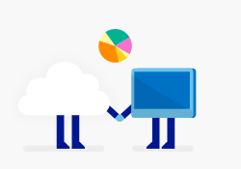
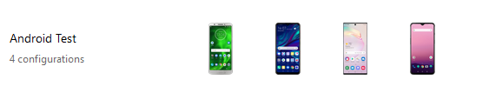



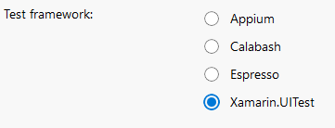




Run your tests on App Center Test Cloud
Run on first device when ready
Configure your run by selecting
Upload package and UI Test
using nodeJs and following
app center instruction
appCenter
Validation
Wait for
devices
Run on second device when ready
Generate report for results
Run on third device when ready
Run on nth device when ready
February 2020
Copyright © 2020 Syncfusion, Inc. All rights reserved.

Slide 31
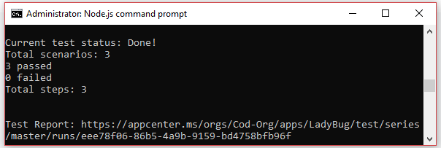
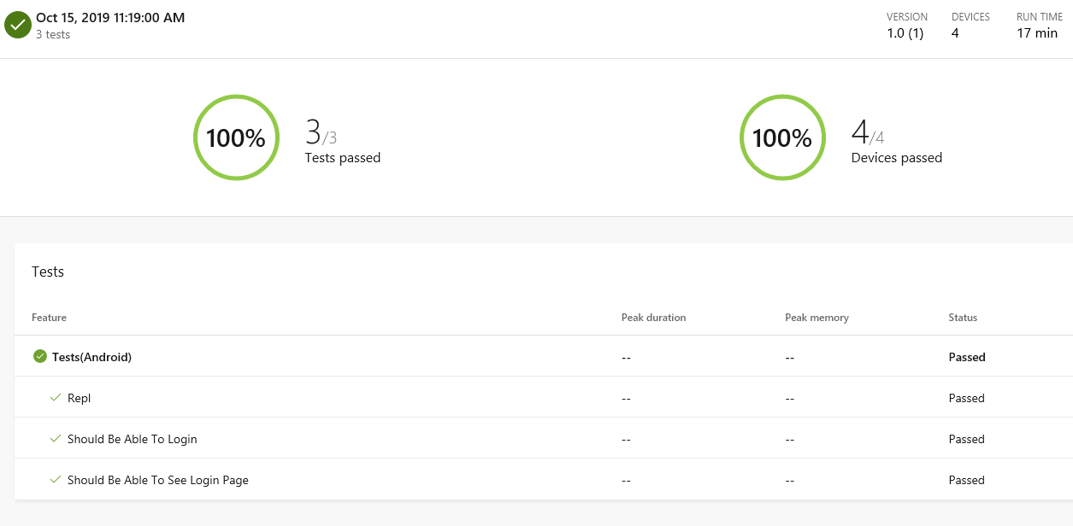
App Center Test Cloud Reports
February 2020
Copyright © 2020 Syncfusion, Inc. All rights reserved.

Slide 32

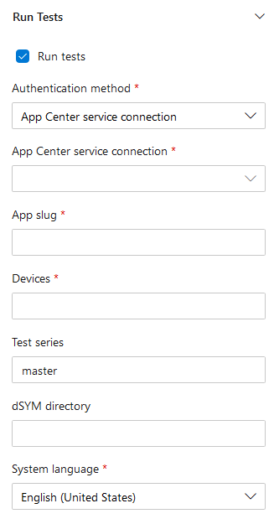

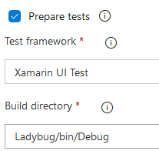
Add UI Tests to DevOps using AppCenter
Enable task
From app center you get:
appcenter test run uitest
--app "codrinamerigo/LadyBug"
--devices "codrinamerigo/android-test"
--app-path pathToFile.apk
--test-series "master"
--locale "en_US"
--build-dir pathToUITestBuildDir
February 2020
Copyright © 2020 Syncfusion, Inc. All rights reserved.

Slide 33
From my experience . . .
UI Tests aren't compatible with the Shared Mono Runtime, so remember to disable it for Android!
For debug purpose, right-click on the iOS Project > Options > Compiler and add the string ENABLE_TEST_CLOUD
If sometimes, the iOS simulator doesn’t pop on the screen,
might be useful to delete the xdb folder inside TMPDIR (on the Mac machine) and retry.
Try to write no more that 20 ui tests per project to run them locally…
Open the Android simulator on your Mac before running the tests
Don’t forget about your UI Test – try to keep them live
February 2020
Copyright © 2020 Syncfusion, Inc. All rights reserved.
Notes:
Don’t use the shared runtime: You can turn off the shared mono runtime from the project properties. In Visual Studio for Windows you’ll find it in the ‘Android Options’ tab at the top of the ‘Packaging’ page, on Mac it’s on the ‘Android Build’ tab at the top of the ‘General’ page. Untick the ‘Use Shared Mono Runtime’ box to turn this off, but be aware that this increases your build times.
Release builds: Release builds don’t have the shared mono runtime turned on. After all, when you build a release version it’s usually for deployment such as to the store, and your users won’t have the shared mono runtime installed. The downside to using a release build is that you need to grant your app permission to access the internet. This isn’t a problem if your app already accesses the internet, but if it doesn’t you many not want to ask your users for this extra permission as they might not want to grant it. If you want to use a release build, then you can grant this permission in Visual Studio by opening the project properties, heading to the ‘Android Manifest’ tab and finding the INTERNET permission in the ‘Required Permissions’ list and ticking it. On Mac, double-click on the AndroidManifest.xml file in the Properties folder and tick the permission.

Slide 34







ALL THE TOOLS. ONE FLAT FEE. NO HASSLE.
Connect with us on social media:
Give us a call:
Toll Free: +1 888.936.8638 (US) Phone: +1 919.481.1974 (World) Send us an email:
sales@syncfusion.com
_Codrina_
January 2020
Copyright © 2020 Syncfusion, Inc. All rights reserved.

